Slide 1
SACO INTERIOR FIT-OUT
COMPANY PROFILE

Slide 2
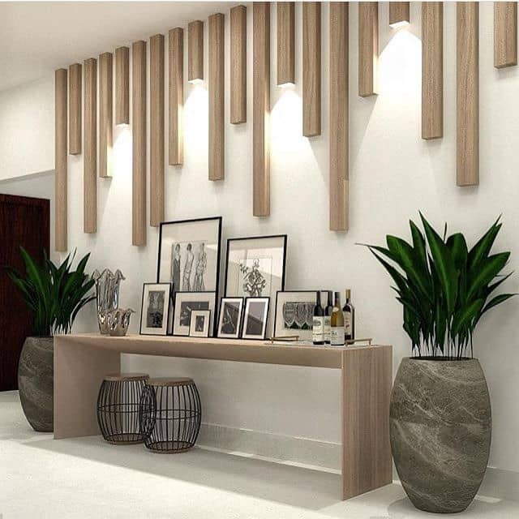
ABOUT US
SACO INTERIOR FIT-OUT
Saco Interior Fit-out manufactures Civil and Interior Fit-out , Custom-made joinery, Finishes, and Furniture for offices, showrooms, homes, hotels, bars, restaurants and any other all kinds of joinery works made in our own factory.

Slide 3
OUR HISTORY

Slide 4
OUR VISION
To be a world-leading and trusted manufacturer of high-quality furniture, and to aim for the fulfilment of our business partners, clients, and employees.
OUR MISSION
To consistently provide sustainable, high quality projects, workmanship and client service while maintaining the utmost professionalism, honesty, and fairness in our dealings with clients, employees and suppliers.
OUR CORE VALUES
QUALITY AND VALUE-We place a high value on the quality of our products, which requires passion and commitment.
INNOVATIVE-We apply innovative thinking and creativity to every work we do.
PASSION-We express our enthusiasm and passion for the sector we are part of.
TEAMWORK-We work in a coordinated manner by giving our best effort to achieve quality outcomes.
INTEGRITY-We are committed to standards of honesty, fairness and respect.
CUSTOMER SATISFACTION-We prioritize our clients’ preferences and specifications.

Slide 5
OUR OWNERS

Slide 6
OUR TEAM
Our team demonstrates strong skills and knowledge to deliver high-quality, on-time products that contribute to your success. We maintain a subtle accessibility and working relationship that ensures our clients receive full-time attention whenever they require our assistance.

Slide 7
OUR SERVICE
3.INTERIOR DESIGNS AND FIT-OUT
We offer high-quality interior design services to customers throughout Dubai and the UAE. From interior design and decoration to fit out work, We have a variety of interior design services available. We provide a diverse range of interior design services to our clients and customers
2. JOINERY
We offer state-of-the-art carpentry and joinery services in Dubai. We cover everything from repairing your existing woodwork to designing the most elegant wardrobes, cabinets, beds, and other carpentry tasks. We can provide the best carpentry services in Dubai
FINISHES
Saco Interior Fit-out offers outstanding Interior Finishing services in UAE, Our finishing services enhances the beauty, convenience, and functionality on every aspect.
5. CNC CUTTING
We provide a high-quality, CNC cutting and routing services or a wide range of materials throughout the UAE. we have a years of experience in the field of CNC.
4. FURNITURES
We are the ideal partners to assist you in designing your ideal customized furniture UAE. We design everything from traditional to modern and highly customized furniture to radically transform your space. You only need to decide on the design of your interiors, and we'll produce it at a reasonable rate. Our showroom features a wide range of our furniture sections.

Slide 8
1.FINISHES
FLOOR FINISHES
WALL CLADDING
WOODEN CEILING FINISHES

Slide 9
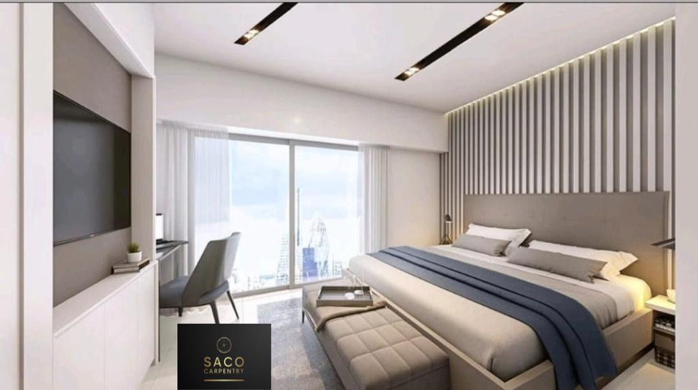
2. JOINERY
Custom-made Joinery
Wardrobes
Walk-in Closets
Wooden Doors
Kitchens
Shelves

Slide 10
3. INTERIOR DESIGNS AND FIT-OUT
Interior Design
Renovation Design
Civil Works
Walls customization
Windows and Doors

Slide 11
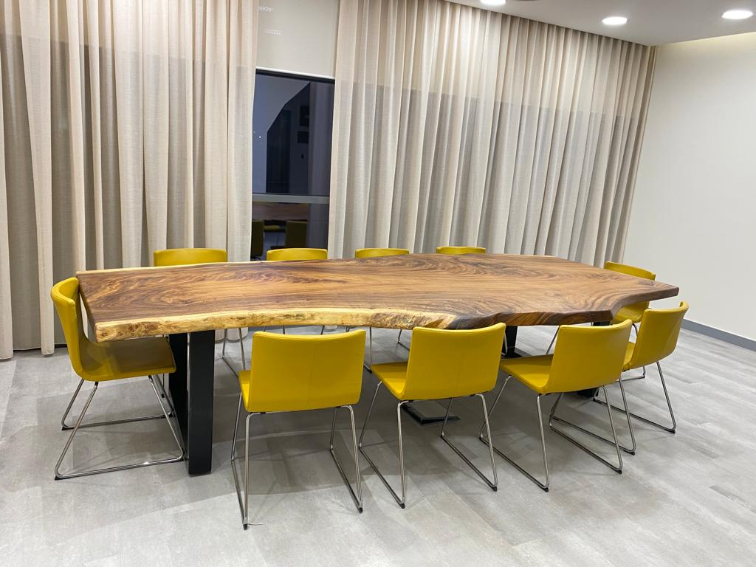
4.FURNITURES
Custom made furniture
Reception Desks
Sofa
Tables
Chairs

Slide 12
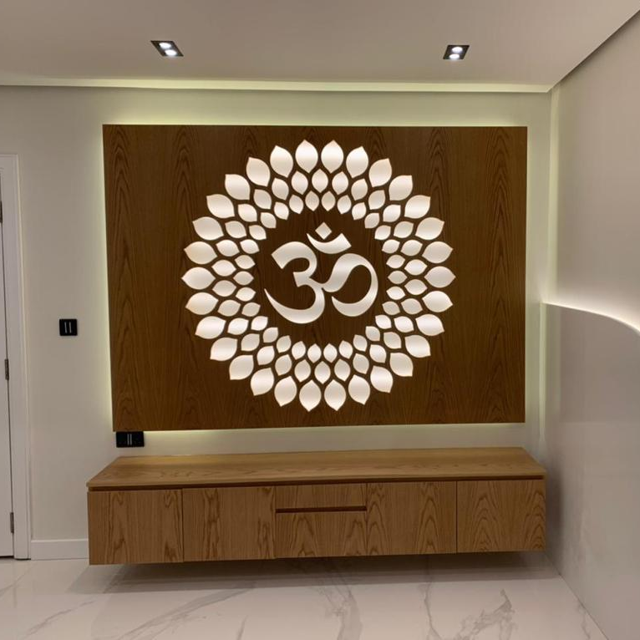
5. CNC CUTTING

Slide 13
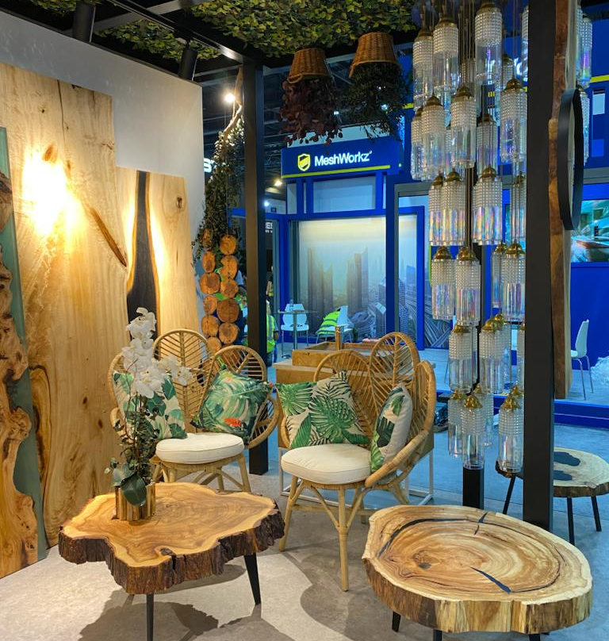
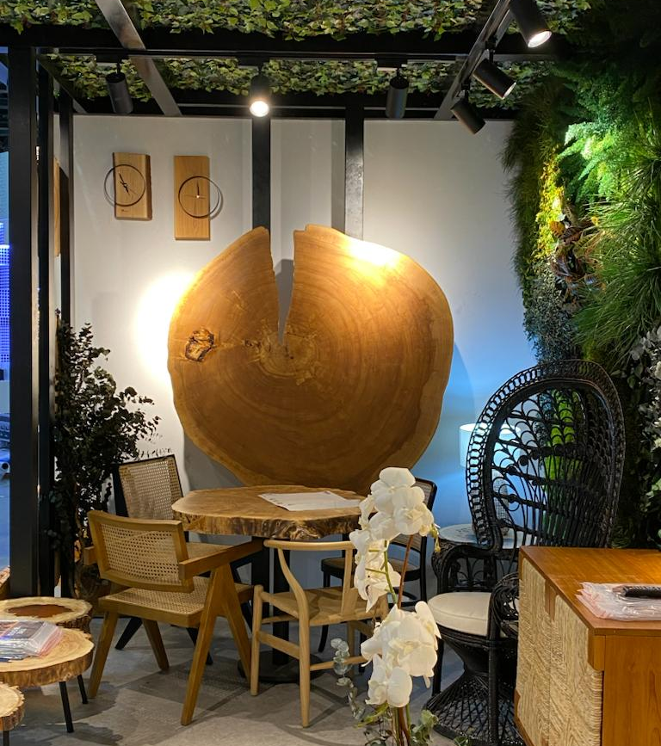
PROJECTS
Handicrafts Poland
-Index Trade Center Dubai

Slide 14
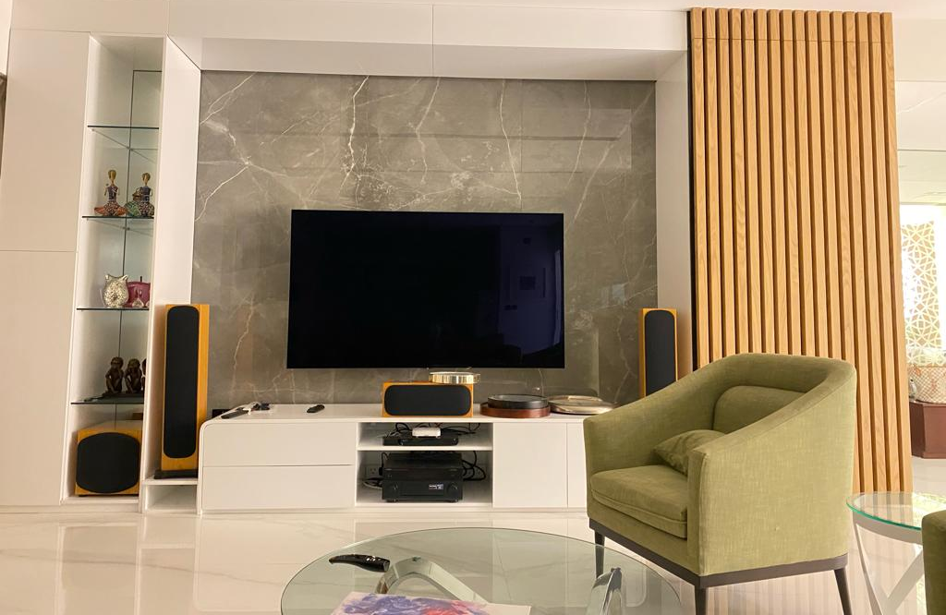
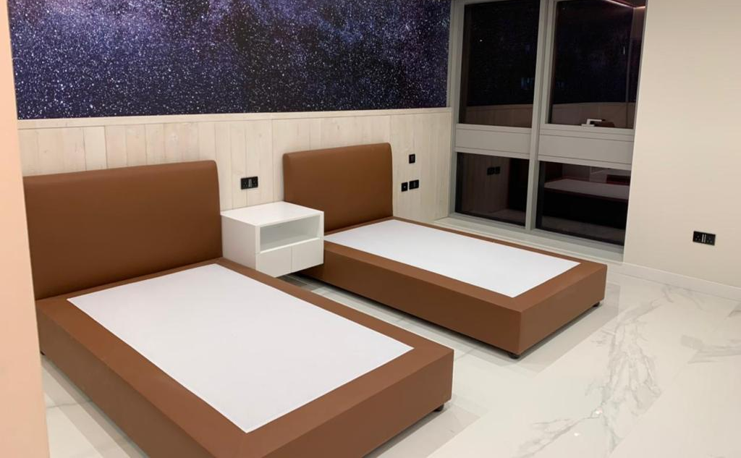
PROJECTS
Raj Apartments

Slide 15
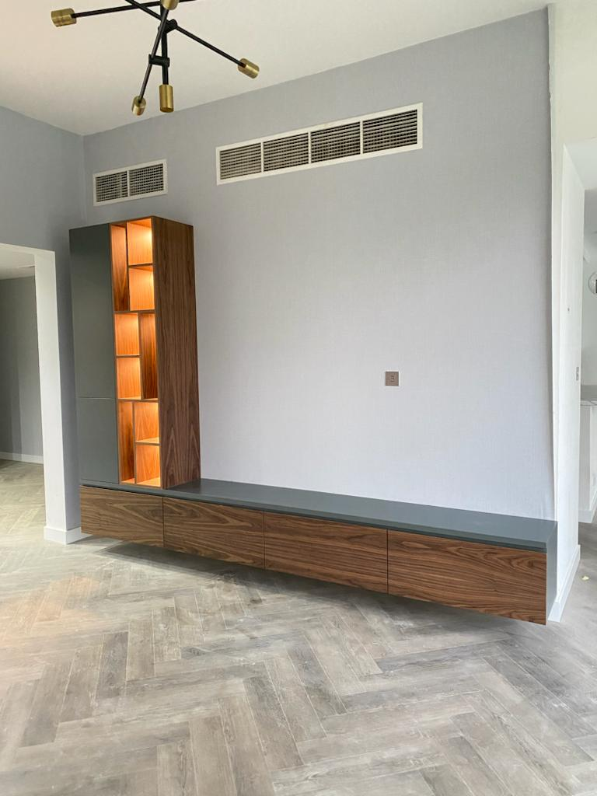
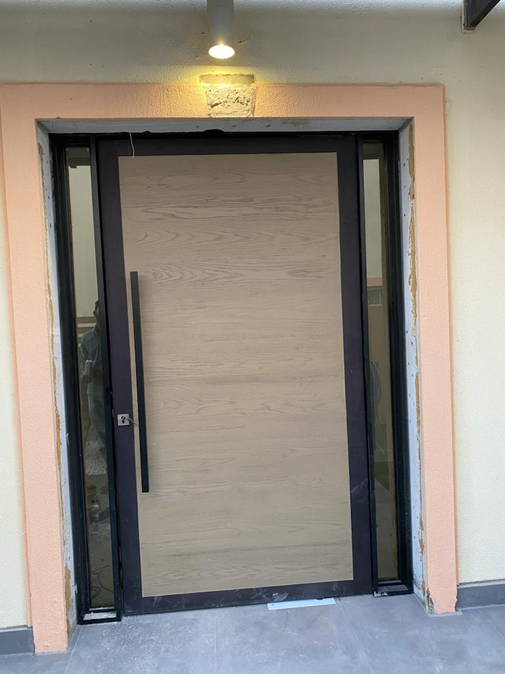
PROJECTS
Spring 19 Villa

Slide 16
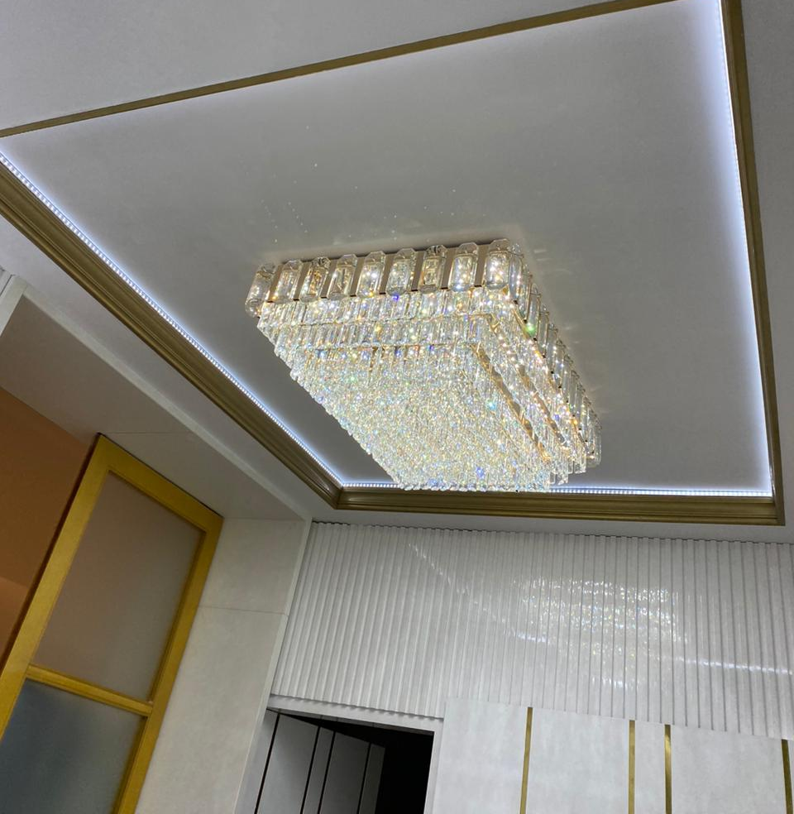
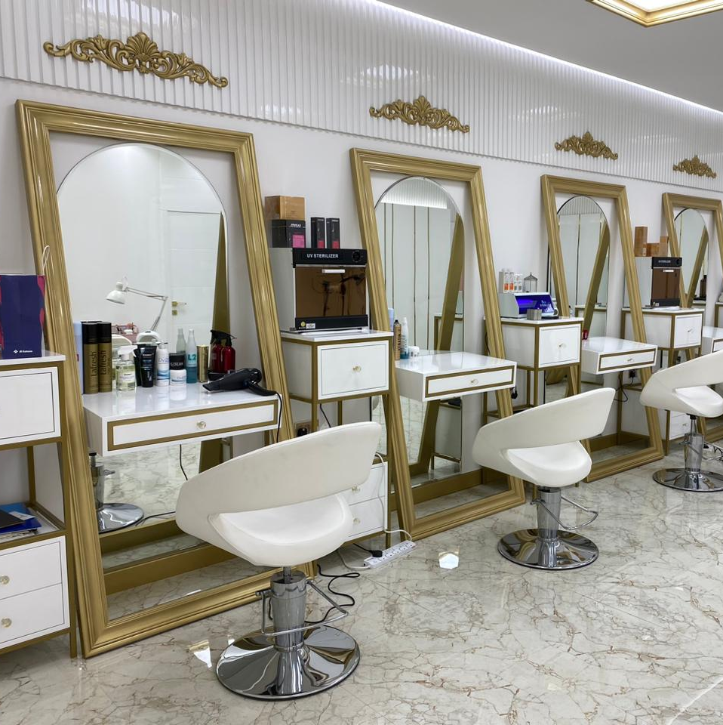
PROJECTS
Spa and Salon
-Arjaan by Rotana Hotel

Slide 17
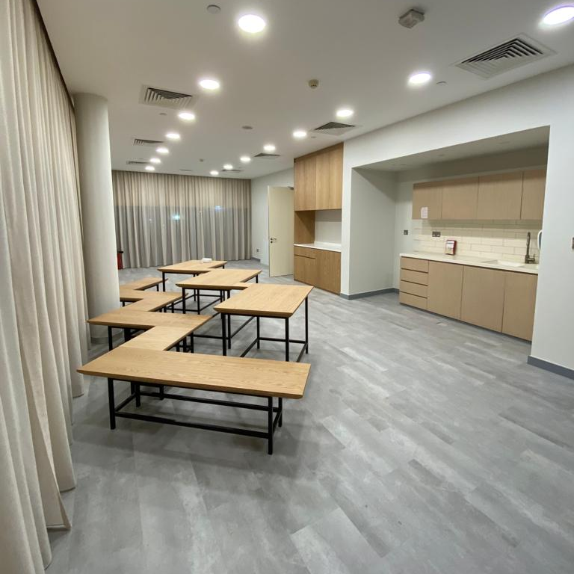
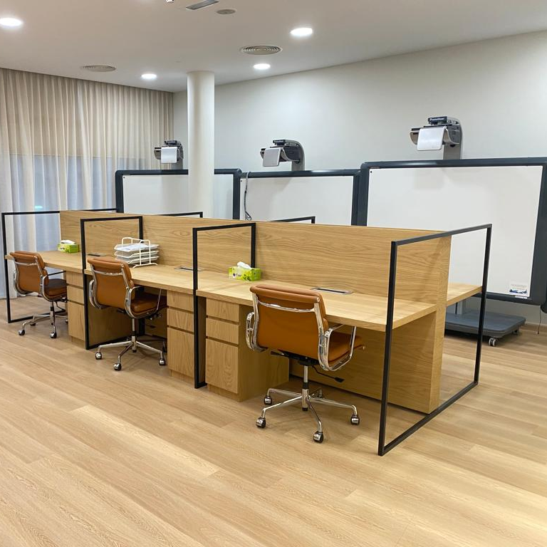
PROJECTS
Blossom School Nursery
-Al Barsha, Dubai

Slide 18
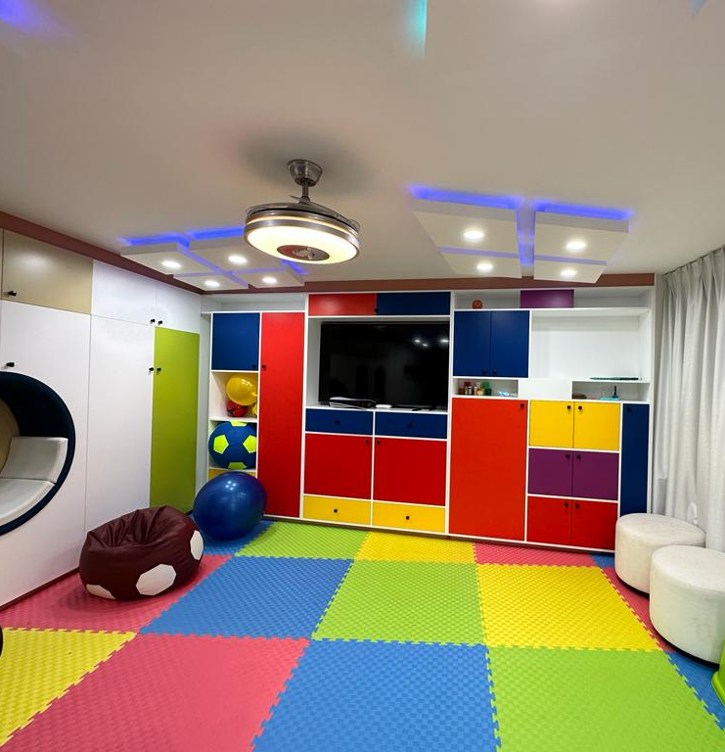
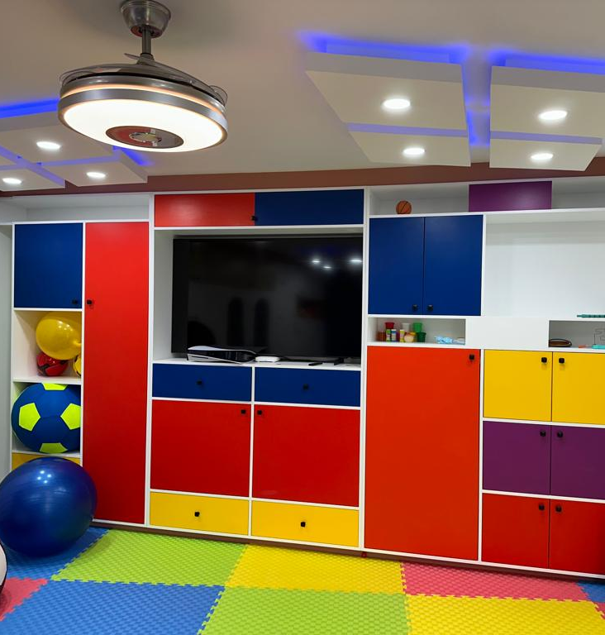
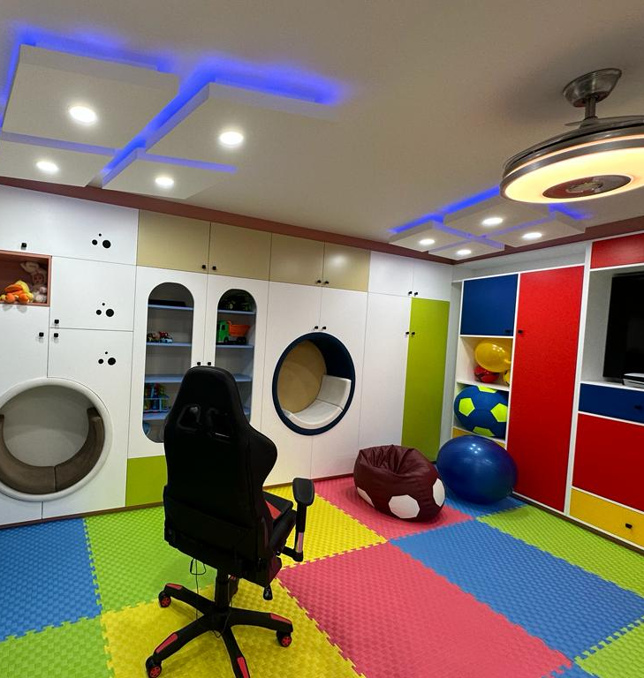
PROJECTS
And Al Sheba Villas

Slide 19
VISIT US OR CONTACT US
PHONE :+971555980015 or +971559262811
EMAIL: info@sacointeriorfitout.com
WEBSITE: www.sacointeriorfitout.com
ADDRESS: Al quoz, Industrial 3, Dubai, UAE
INSTAGRAM: @saco_carpentry

